Slide 1
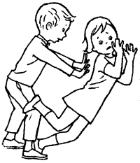
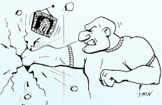
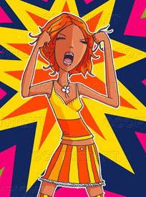

Drawing the line: Types of family violence and abuse
Eddie Gallagher
2013

Slide 2
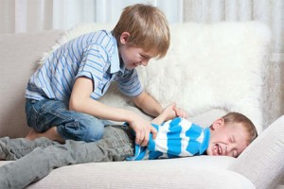
Sibling Violence 1
The most common form of family violence
Estimated up to 80% or even 90% of children
More common than partner violence, physical child abuse or violence to parents (possibly combined)
Is it helpful to regard almost all children as ‘abusers’?
Is it trivial? Or is it serious?
It’s both
Where does violence become abuse?
Where do we draw the line?

Slide 3
Sibling violence 2
Murder
Serious Abuse
Play fights, bickering
Mutual fights, teasing
Bullying
Intention
Persistence & frequency
Seriousness
Emotional abuse
Vulnerability
Power differences

Slide 4
Sibling violence 3
Most sibling violence does not result in serious injury. Surprising how seldom sibling fights cause black eyes, blood noses, etc. Most pull their punches
Doesn’t usually escalate. May get more serious around puberty as they get bigger, then usually declines in teen years
Most violent combination is close in age brothers, but worst abuse is with wider age-spacing and often brother to younger sister

Slide 5
Sibling violence 4
On-going sibling abuse causes depression, anxiety, anger, loss of self-esteem, affects education and socialisation. Increases likelihood of being both victim and a victimiser
Affects can last a life-time
Can make childhood miserable
Older sibs are major role models. Some studies suggest bigger influence than parents in adolescence for some behaviours

Slide 6
Sibling violence 5
Many children fight more when parents are around
But abuse more likely when parents are not around
Smaller families may reduce physical abuse but increase emotional intensity
Children are indoors and forced into the company of sibs in an historically new way
When older sibs looked after younger ones there may have been less fights but more serious abuse

Slide 7
Sibling violence 6
Parents having less control means more opportunity for sibling fights and sib abuse
Parent abuse and sibling abuse often go together
Every form of family violence is correlated (genetics, social class, neighbourhood, family culture, etc)
Exposure to IPV increases risk of sibling abuse and of parent abuse
Child abuse increases risk of sibling abuse (but not often of parent abuse)
Parents seldom take sibling abuse seriously enough

Slide 8
Working with sib violence
Recognise parents limited power, they may be doing all they can
But some parents can be encouraged to take it more seriously and have clearer boundaries and consequences
Be cautious of family meetings or family therapy, can be useful but can also be pointless or harmful
Difficult to work with abusive kids as they often don’t see anything wrong with the behaviour

Slide 9
Violence & Abuse
Boys & girls found to be equally violent when widest definition is used (for sibs and for CPV)
We don’t assume that 80% physical violence between sibs means that most of this is ‘abuse’
With other forms of family violence, the highest rates of violence are quoted as being the rate of ‘abuse’, even though this suggests gender equality in violence, and that most violence is mutual
Not all hitting, pushing, throwing objects is ‘abuse’

Slide 10
6 types of violence
Playful violence (play fights, mild teasing, tickling)
Ritual violence (sports, initiation, religion, legal retribution)
Defensive violence (responding to an attack)
Mutual combat (non-playful, two-way fights)
Instrumental violence (control, profit, entertainment, pride)
Expressive violence

Slide 11
Which are ‘abuse’?
Smacking a 3 yr-old for running on the road.
Smacking an 8 yr-old for not being able to read.
10-yr-old boy gives 14-yr-old brother a black eye in a fight.
10-yr-old gives his 4-yr-old brother a black eye in play fight.
Baby biting his mother.
10-yr-old biting his mother.
10-yr-old saying “I hate you!” to a parent.
Parent says “I hate you!” to 10-yr-old
15-yr-old threatens suicide if he doesn’t get a motorbike

Slide 12
What is ‘abuse’?
“There will never be an accepted or acceptable definition of abuse, because abuse is not a scientific or clinical term. Rather, it is a political concept.” Gelles & Straus 1988
Context and meaning cannot be left out when considering if violence is ‘abuse’ or not.
Including all forms of violence, without context, makes gender disappear, makes most violence appear mutual and makes it appear very common. Most surveys are not valid measures of ‘abuse’

Slide 13
Abuse and power
‘Abuse’ often defined by hurtful or injurious behaviour plus power difference
But what power does an 8-year-old have who is abusing his parents, or his teenage sister?
There is potential power in being a man in our society, but only irresponsible men make full use of it. If the father is more responsible than the mother, she has more power than him
After separation responsible men feel powerless

Slide 14
Power
Parents potentially have more power than children, but constrained by:
  Loyalty, guilt, shame, convention, habit, confusion and especially by trying to keep the “peace”
Being irresponsible gives power! Not caring gives power
Being self-destructive can be incredibly powerful!
If teen-terrorists can take-or-leave home they can be more powerful than caring parents
Some workers reinforce teen’s power over parents and increase parental guilt

Slide 15
Power
Power differences are often a defining aspect of ‘abuse’, e.g. colleague makes sexual invitation versus boss makes same suggestion
Power, like a weapon, only gives advantage to those willing to use it
Schools are powerless over the child who wants to be expelled. Suspension often seen as a reward
This aspect of power plays big part in IPV as well as violence to parents and sibling violence

Slide 16
Power
The small number of genuine role reversals, women abusing and controlling male partners, can be understood in terms of the power of being irresponsible
The slightly larger numbers of couples where violence is mutual are understandable if Patriarchal power and physical strength are constrained
“Patriarchal terrorism” is real and feminist theory of family violence is correct… but incomplete. Violence to parents and sib violence can’t be explained by gender, though it plays a part

Slide 17
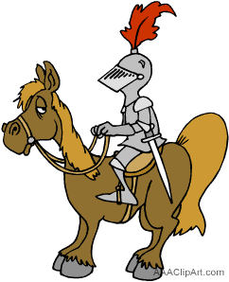
Chivalry
Chivalry does exist. Girls in my sample are as likely to hit their fathers as are the boys, despite almost all being physically weaker than father
Some boys will punch their brothers but push or slap their sisters… useful aspects of chauvinism
‘Rules for hitting’ illustrate self-control,

Slide 18
Abuse is not about love or lack of love
Abuse is about lack of respect
Children who abuse parents, and men who abuse wives, may be normally attached, unattached, or over-attached (clingy & dependent).
Abuse is about control and power, but seldom conscious and thought out manipulation.
Abusers seldom feel powerful and high-entitlement may mean they feel less powerful.
Many abusers see themselves as victims.

Slide 19
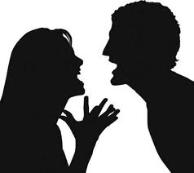
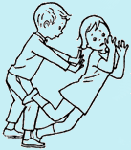
Gender of abusers
IPV
CPV
Overwhelmingly male
A third female (proportion may be increasing)
Sib Abuse
Probably similar to CPV

Slide 20
Gender of victim
IPV
CPV
Overwhelmingly female
Mainly mothers (70%+) but in 2-parent homes half of fathers also abused
Sib Abuse
More violence to male sibs, but serious abuse victims more often female

Slide 21
Duration and course
IPV
CPV
May start slowly and often escalates over many years
Various patterns: often slow onset, escalating with adolescence. A few ‘grow out of it’ but others leave home
Sib Abuse
Varies with ages of both children. Doesn’t usually escalate in same way as IPV and CPV

Slide 22
Effects on victim
IPV
CPV
Depression, extreme stress, loss of self-esteem, feeling trapped, anger
Same as IPV, but may feel even more trapped as can’t contemplate separation
Sib Abuse
Similar. Effects on self-esteem may be longer lasting. More likely to copy the aggression

Slide 23
Effects on abuser
IPV
CPV
May minimise all problems until forced (legally or by separation) to face issues
Often unhappy and may stress themselves. Put themselves at risk by alienating their family. Practicing abuse likely to affect later relationships.
Sib Abuse
Unless parents or authorities take action, they tend to trivialise the behaviour and it may have little effect. May increase chances of later abusive behaviour.

Slide 24
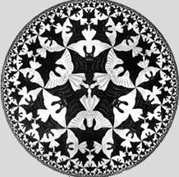
Shades of grey
We tend to view abuse and violence in black and white terms.
Sometimes it is… but we need to live with fuzzy shades of grey

Slide 25
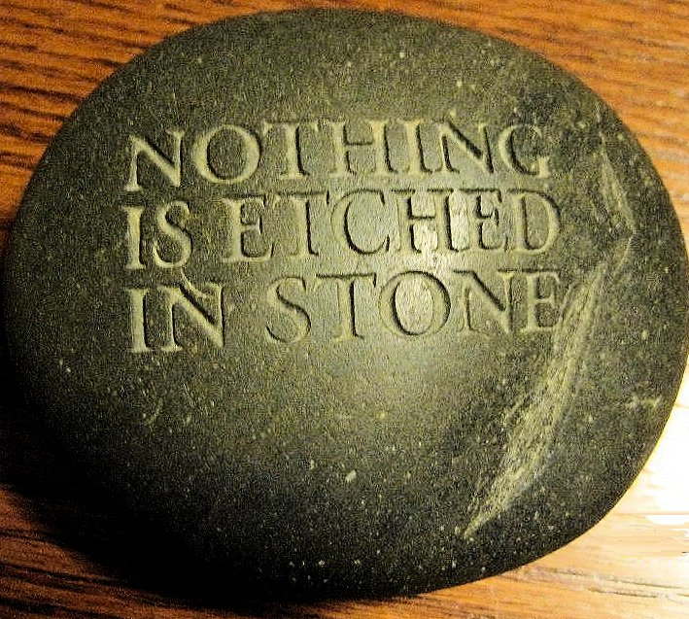
©Eddie Gallagher 2013 www.eddiegallagher.com.au

