Slide 1


Who’s in Charge?
MYTHS OF ANGER!
Notes:
Handout:
Anger is usually associated with violence and is often seen as a root cause.
More often than not it’s about not being able to regulate a person’s emotions.
We here phrases like someone was killed in cold blood – it was calculated – there was no anger
In fact sometimes there is calm. Some of the most dangerous individuals are emotionless psychopaths.
I recall getting into scrapes myself as a youngster and there was no anger present it was about winning
Or pride or competition.
Throughout history and in most cultures the vast majority of acts of violence were not motivated by anger

Slide 2
Myths of anger
“Anger is an acid that can do more harm to the vessel in which it’s stored than to anything on which it is poured.”
(Mark Twain)
Notes:
Intro:
Anger is just one of a range of emotions.
Although we do speak about people causing other emotions i.e my bundle of joy or
“he made me sad when he shared that with me”
Often it’s anger that we single out as being caused by other people
Maybe it’s because we use anger as an excuse for our worst behaviour.
And maybe it’s because when we are very angry we revert to simplistic,
More black and white thinking as we are unable to think as clearly.
So the focus when we are angry is the object of our anger.
Think about this as we run through the presentation.

Slide 3
Myths of anger
Other people make us angry
Their intention, not action, is important
Actually our interpretation of their intention
How much threat do we perceive (pride, self-esteem, role expectations, etc.)
Fear can suppress anger
Humour can cancel anger
Notes:
We can choose to get angry: game shows, sports commentators, politicians, injustice etc.
Imagine a drunken teenager provoking a group of older men
A group of older men may just laugh at him – even though his behaviour may be unacceptable
(he’s not worth bothering with) (don’t let him get to you) They realise they have a choice
Picture an angry driver making hand gestures at others
Some other drivers may just laugh at them getting so heated
Imagine the drunken teenager as your son – you may say he caused you to get angry
But what if his girlfriend had dumped him, his uncle had died and he was drunk for the first time.
Would your response be the same?

Slide 4

Myths of anger
Feelings cause behaviour
I just saw red
I was so angry
I couldn’t control myself
I went from 0-100 instantly
95% of men who are violent towards a partner would stop if a policeman appeared
Of the remaining 5% who are unafraid of the police or prison, most would stop if their mother arrived.
Notes:
If all this were true how come we are not shouting, hitting and hurting people all over the place?
What is it about the arrival of the police that causing them to stop – are the police so soothing?
It’s the potential consequences of the police appearing that changes the behaviour
If people really are out of control, then why are there not far more murders
Men are often careful not to leave bruises when assaulting their partners
Siblings seldom cause ‘real’ injuries even when there are differences in size and strength.
Adults and children smash things but there is usually a pattern so the rage is controlled on some level.
Only my own things, only my Mums, only expensive things, nothing expensive, things that make a
Satisfying sound when smashed.
We don’t talk about other feelings in this way.
I was just too excited, I couldn’t go to school/work today doesn’t seem plausible
No sane person would talk about strong sexual urges as an excuse for rape
It’s only anger that causes us to talk as forcing us to behave in another way.

Slide 5
Myths of anger
Anger is automatic
We always make ourselves angry by our thoughts and attitudes
This may be almost instantaneous, or slow-building for months or years
Generally we work ourselves into a rage by a sequence of winding-up thoughts and actions
Once in a rage we don’t want to stop
Even children and the disabled can learn control

Slide 6

Myths of anger
Anger causes violence
Many people are quite violent without being angry (instrumental violence)
Other people are frequently angry but never violent
Women are just as angry as men, but far less violent
Most people are only violent to ‘safe’ targets
Pride, loyalty, desire to control all just as important as anger in most violence

Slide 7
Their choice, possibly influenced by our actions
Someone else’s behaviour
Our choice, though we seldom think about it, people vary greatly in perceptions of threat
Our interpretation of their intention
Some choice, though may feel out of our control
Our emotional reaction
Entirely our choice, though rage or despair may make us feel we have no options
Our behaviour
Other people far more likely to react negatively when we are negative (short & long term)

Slide 8
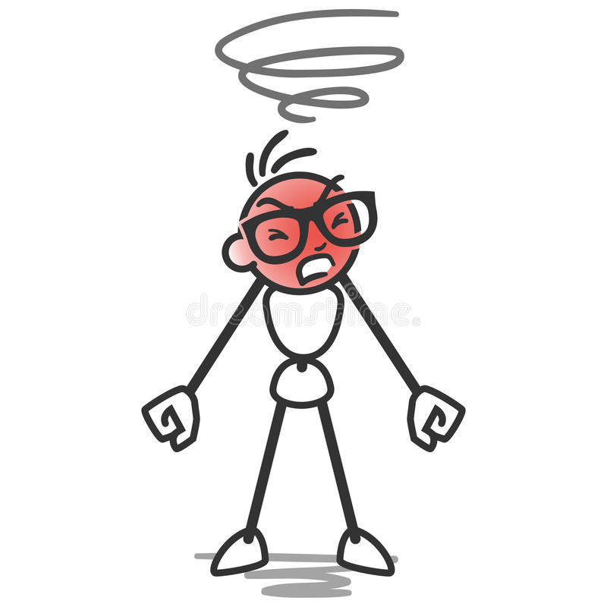
Myths of anger
Anger builds up and needs release
Resentments, habits and negative cycles all do build up over time
Anger is not a substance and can’t be stored in the nervous system
Acting angry makes us more angry (habits of feelings, thoughts as well as actions)
Downward spirals in relationships can result in more negative behaviour
Notes:
Anger is not a substance and can’t be stored up.
Certain things which can build up which often result in increased anger
Having constant angry thoughts can build up and become a negative thinking habit.
As a child becomes more demanding the parent begins to give up as the child loses more and more respect for them
This can lead to a rigid and aggressive styleof parenting for example.

Slide 9
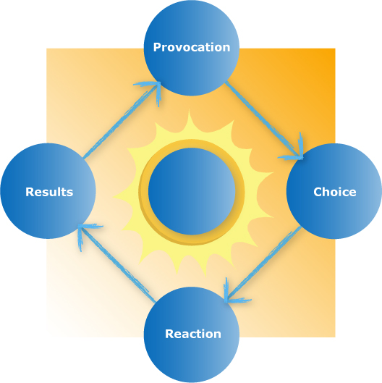
Myths of anger
Notes:
Anger is a choice

Slide 10

Problems with anger Management
Anger is only part of the picture
Anger is often used as an excuse for abuse – so focussing on anger not always useful
Motivation usually needs to be cultivated
Motivation may vanish when individual feels justified
Once in a rage we don’t want to calm down
Most rage is Righteous rage!

Slide 11
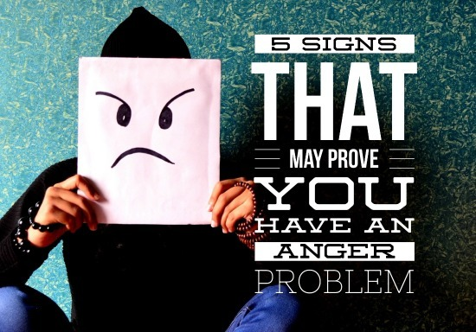
Problems with anger Management
People may make themselves angry in order to achieve a goal (control, power, excitement, attention)
Attitude change often necessary before any techniques will be used
… but attitude change and techniques can reinforce each other

Slide 12
Anger de-fusing techniques
Distracting and slowing techniques
Relaxation and calming techniques
Countering winding-up thoughts
Using winding-down thoughts
Focusing on longer-term outcomes
Fostering victim empathy
Teaching/encouraging alternative communication and problem solving strategies

Slide 13
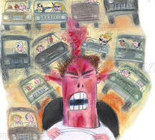
Attitudes that increase anger
Defensiveness
Self-centeredness
Competitiveness
Entitlement
Lack of trust
Equating power over others with strength
Desire to control others
Macho ideals

Slide 14
Anti- anger affirmations
“People have the right to make mistakes.”
“I don’t have to prove anything to anyone.”
“The world doesn’t have to be perfect for me to be happy and get along with people.”
“If other people are irresponsible, rude or thoughtless it doesn’t help if I act the same way.”
“Aggression is childish, not manly. I must get rid of stupid ideas about being macho.”
“My rage and anger are usually childish. I can tell my inner brat to go to hell!”
“I look like an idiot when I’m in a rage.”
“Self control is strength, lashing out is weakness.”

